Slide 1

Sign Language Detection Using Deep learning techniques
KIET GROUP OF INSTITUTION, GHAZIABAD
Authors:
Himanshi Tyagi
(CSE Department- himanshi.1923cs1018@kiet.edu)
Shreya Shankar
(CSE Department- shreya.1923cs1010@kiet.edu)
Surbhi Sawan
(CSE Department- surbhi.1923cs1015@kiet.edu)
Supervisor:
Prof. Bharti
(bharti.cse@kiet.edu)

Slide 2
Presentation outline
Research Objective
Introduction
Work on Objective
Literature Review
Dataset Used
Proposed Work
Result
References

Slide 3
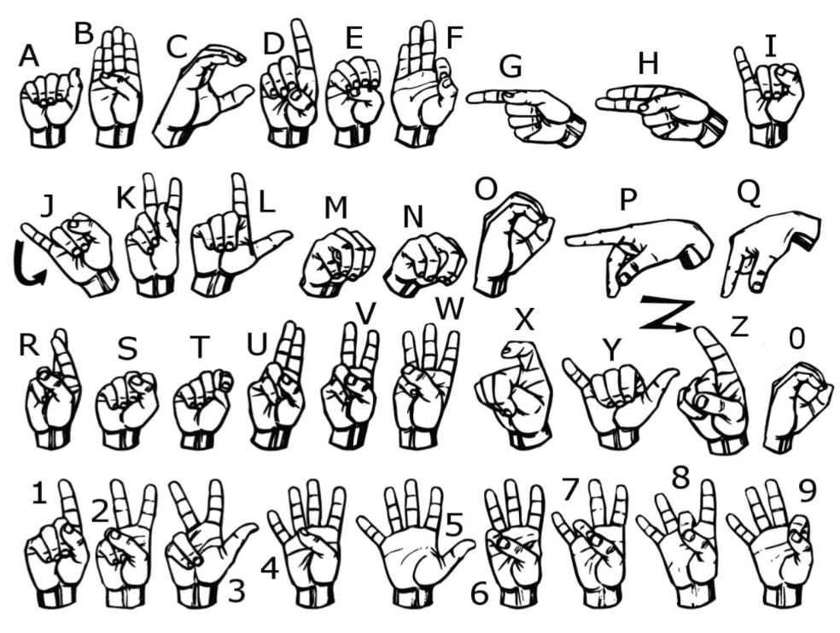
Research objective
Build optimize learning model for ASL using CNN so that communication gap between normal and impaired person can be easily bridged.

Slide 4
Introduction
To communicate words and ideas using gestures and hand movement instead of spoken words is sign language.
Used by deaf people and others who want to communicate using only their hands.
Normal people have trouble understanding and interpreting sign language's meaning.
To address this, we use a custom CNN model to recognize gestures in sign language.
In this work, we have chosen American Sign language(ASL).

Slide 5
Literature Review
Paper Title | Dataset Used | Techniques Used | Evaluation | References
Real-Time American Sign Language Recognition Using Skin Segmentation and Image Category Classification with Convolutional Neural Network and Deep Learning | Hand-signs image dataset | CNN and Deep learning method | Overall test accuracy of 94.7% | [1]
American Sign Language recognition using Support Vector Machine and Convolutional Neural | MNIST-Kaggle dataset [3] | SVM with ‘Poly’ kernel & double layer CNN | 81.49% - (SVM) 98.58% -(CNN) | [2]
A Real-Time American Sign Language Recognition System using Convolutional Neural Network for Real Datasets | Hand Gesture Images | CNN | Maximal accuracy of 98.53% | [4]
Real-time American Sign Language Recognition with Convolutional Neural Networks | The ASL Finger-spelling Dataset from the University of Surrey’s Centre for Vision | CNN | 98% with five letters and 74% with ten | [5]

Slide 6
Sign Language Recognition Using Deep Learning and Computer Vision | MNIST-Kaggle dataset [3] | CNN | validation accuracy greater than 93% | [6]
American Sign Language Alphabet Recognition using Deep Learning | The surrey finger dataset [8] | SqueezeNet Model | Validation accuracy of 83.29% | [7]
A New Benchmark on American Sign Language Recognition using Convolutional Neural Network | The Massey University Gesture dataset [10], The sign language digit dataset [11], ASL finger spelling dataset [12], ASL Alphabet dataset [13] | CNN | 100% accuracy for MU HandImage ASL dataset | [9]
A Real-Time System For Recognition Of American Sign Language By Using Deep Learning | dataset collected in 2011 by the Institute of Information and Mathematical Sciences [9] | CNN | 98.05% test performance | [1]

Slide 7
WORKFLOW

Slide 8
Data Collection and Pre-processing
Initially, we utilized a dataset sourced from Kaggle and preprocessed it. However, the results obtained under varying lighting conditions were not as anticipated, so we captured our own hand gesture images.
The image class is represented by the first column, and the rest all represent 28x28pixels. The test data set follows the same paradigm. Before the input data can be fed into the model, it needs to be preprocessed.
Pre-processing is performed to improve data quality and speed up training. The image was transformed to a grayscale image. The highest value of the gray level range is used to normalize the gray levels in the input image. After this transformation, data splitting was performed with a ratio of 80:20.

Slide 9
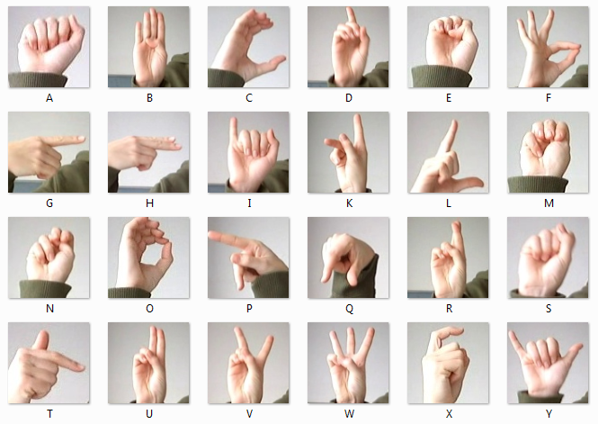
Dataset
ASL MNIST Dataset
(https://www.kaggle.com/datasets/datamunge/sign-language-mnist)
This dataset contains 27455 training images and 7172 test images, all of 28x28 pixel geometry. These images belong to 25 classes from A to Y in the English alphabet (no Z class designation due to gesture movement). The Kaggle dataset is available in CSV format and has 27455 rows and 785 columns of training data. The first column of the data set represents the image class designation and the remaining 784 columns represent 28 x 28 pixels. The test data set follows the same paradigm.

Slide 10
Proposed Work
In this project, we proposed an idea for feasible communication between hearing impaired and normal people with the help of :
Deep Learning
CNN (Convolution Neural Network)

Slide 11
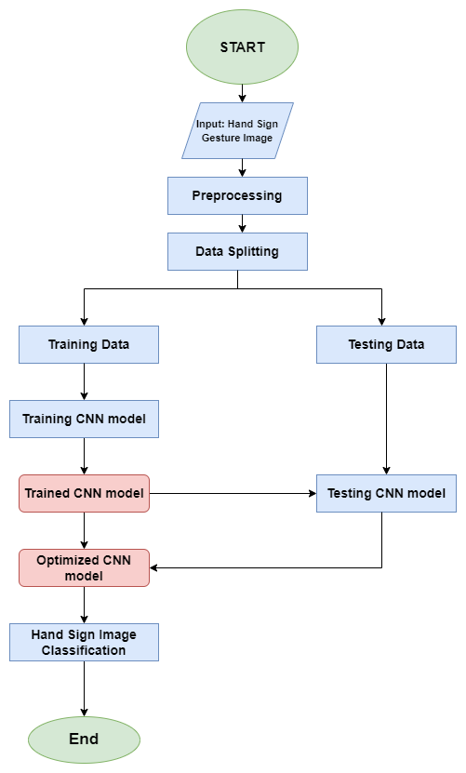
In the following flow chart, we have shown our proposed methodology for sign language recognition. We pre-processed the dataset and then split it into training and testing dataset. Then we train our model with training dataset. Thereafter, we tested our trained CNN model with testing dataset and optimized it.
Fig. Flowchart of Proposed Model

Slide 12
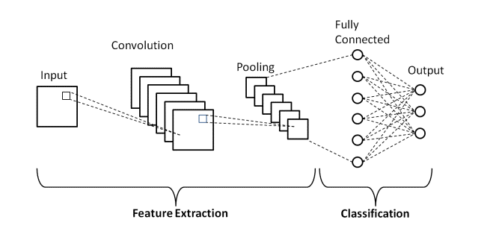
CNN Technique

Slide 13
CNN Architecture Selection
We implemented the following layers in our model:
Conv2D - Convolutional Layer, used for feature extraction, in our model we used 3 Conv2D layer and convolution kernel (3,3).
MaxPooling2D - Calculates largest value in every patch, in out model we used 3 MaxPooling layer which consists of size (2,2).
Flatten - 2D array to linear vector
Dense - Deeply connected layer, where we used 10 dense layer

Slide 14
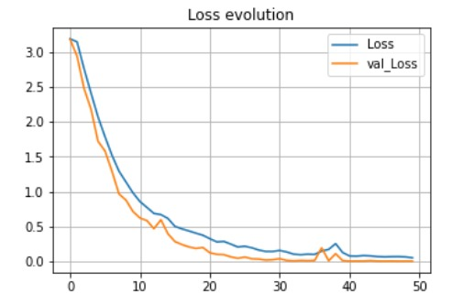
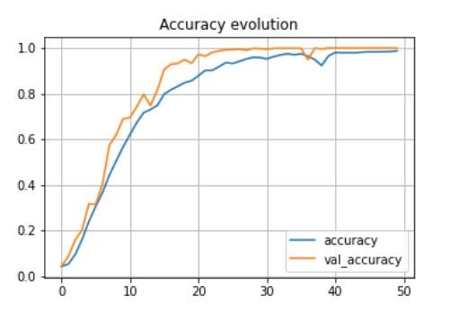
Result
The CNN model is trained against the MNIST dataset, where 27455 are training samples and 784 train features. Cross-entropy ADAM is used for the model to reduce loss. 512 batches of 50 epochs each are used to train the model, which has a 0.001 learning rate. The accuracy of the validation dataset, which has 7172 samples, is 97%.
Fig. Graph of Loss Evolution
Fig. Graph of Accuracy evolution

Slide 15
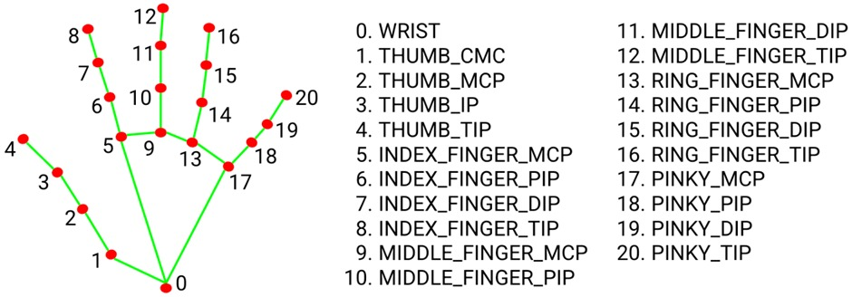
How did we overcome this problem?
We used a different approach by using Google's Mediapipe library as a handtracking module to track our hands which we then mapped the skeleton of hands to a white background.

Slide 16
Conclusion
This paper presents a CNN-based method for recognising and classifying sign language using computer vision. Unlike other approaches, this method yields higher precision than [10].
 | Our Model | Ref[10]
Year | 2023 | 2020
Model | The CNN model developed consists of 15 different layer, three convolutional layer, two pooling (Max) layer, ten dense connected layer | The CNN model developed consists of 11 different layer, four convolutional layer, three Pooling (Max) layer, two dense Connected, one flatten and one dropout layer.
Accuracy | 96.89 | 93%

Slide 17
Limitations and Future Scope
Implementation of translation of letters which requires movement (For ex.Letter Z).
Increasing accuracy of our model.
The project can be extended for other type of information as well like numbers, words and sentences.
This paradigm can be applied to other sign languages, such as Indian Sign Language, but for the time being it is exclusive to American Sign Language.

Slide 18
References
S. Shahriar et al., "Real-Time American Sign Language Recognition Using Skin Segmentation and Image Category Classification with Convolutional Neural Network and Deep Learning," TENCON 2018 - 2018 IEEE Region 10 Conference, 2018, pp. 1168-1171, doi: 10.1109/TENCON.2018.8650524.
Jain, Vanita & Jain, Achin & Chauhan, Abhinav & Kotla, Srinivasu & Gautam, Ashish. (2021). American Sign Language recognition using Support Vector Machine and Convolutional Neural Network. International Journal of Information Technology. 13. 10.1007/s41870-021-00617-x.
Kaggle (2017) Sign language MNIST: drop-in replacement for MNIST for hand gesture recognition tasks. https://www.kaggle. com/datamunge/sign-language-mnist. Accessed Jan 2018
Rasha Amer Kadhim 1 , Muntadher Khamees . “A Real-Time American Sign Language Recognition System using Convolutional Neural Network for Real Datasets”.doi: 10.18421/TEM93-14, August 2020

Slide 19
References
Real-time American Sign Language Recognition with Convolutional Neural Networks . Brandon Garcia Stanford University Stanford, CA. Sigberto Alarcon Viesca Stanford University Stanford, CA.
R.S, Dr.Sabeenian & Bharathwaj, S. & Aadhil, M.. (2020). Sign Language Recognition Using Deep Learning and Computer Vision. Journal of Advanced Research in Dynamical and Control Systems. 12. 964-968. 10.5373/JARDCS/V12SP5/20201842.
Kasukurthi, Nikhil, Brij Rokad, Shiv Bidani, and Dr Dennisan. "American Sign Language Alphabet Recognition using Deep Learning." arXiv preprint arXiv:1905.05487 (2019).
Zimmermann, C., & Brox, T. (2017). Learning to Estimate 3D Hand Pose from Single RGB Images. arXiv preprint arXiv:1705.01389.
Rahman, Md Moklesur, Md Shafiqul Islam, Md Hafizur Rahman, Roberto Sassi, Massimo W. Rivolta, and Md Aktaruzzaman. "A new benchmark on american sign language recognition using convolutional neural network." In 2019 International Conference on Sustainable Technologies for Industry 4.0 (STI), pp. 1-6. IEEE, 2019.

Slide 20
References
A. Barczak, N. Reyes, M. Abastillas, A. Piccio, and T. Susnjak, “A new 2d static hand gesture colour image dataset for asl gestures,” 2011.
F. Bes¸er, M. A. Kizrak, B. Bolat, and T. Yildirim, “Recognition of sign language using capsule networks,” in 2018 26th Signal Processing and Communications Applications Conference (SIU). IEEE, 2018, pp. 1–4.
B. Garcia and S. A. Viesca, “Real-time american sign language recognition with convolutional neural networks,” Convolutional Neural Networks for Visual Recognition, vol. 2, 2016.
A. Deza and D. Hasan, “Mie324 final report: Sign language recognition.”
” A Real-Time System For Recognition Of American Sign Language By Using Deep Learning” Murat Taskiran, Mehmet Killioglu, and Nihan Kahraman Electronics and Communications Engineering Yildiz Technical University Istanbul, Turkey

Slide 21

THANK YOU

